Slide 1
Creating Sandboxed Solutions
Developing and Deploying Partially Trusted Code
Notes:
Microsoft introduced the concept of sandbox solutions which empower site collection owners to deploy custom code without access to the servers or involvement by the IT group. In this module you’ll learn how to create sandbox solutions, the limitations that come along with them as well as how to break out of the sandbox.

Slide 2
Agenda
Understanding Sandboxed Solutions
The Sandbox Execution Environment
Sandbox Resource Monitoring
Breaking Out of the Sandbox

Slide 3
Farm Solution Deployment
SharePoint 2007 introduced solution packages
Solution deployment only supported at farm level
Solution deployment requires farm administrator
Farm level deployment poses risks to farm
Solution packages install files on Web server
Solution packages usually install DLL in GAC
Solution packages often require updates to web.config
Risk reduced with QA testing and code reviews
But it creates bottlenecks getting code into production
Notes:
Prior to SharePoint 2010, the vast majority of custom code had to be deployed to the global assembly cache (GAC). Because of this, developers often operated with full trust in the SharePoint server not only to call any part of the object model, but also to access databases, Web services, directories, and more.
The key point is that nearly all code in the farm ran with full trust and farms were occasionally destabilized by custom code. To make matters worse, the offending assembly was often hard to identify. As an example, consider the case in which an intermediate-level SharePoint developer is writing.

Slide 4
Reducing Risk in SharePoint 2007
Web Part DLLs can be deployed to bin directory
Eliminates need to deploy assembly DLLs in GAC
Code deployed to bin directory runs with partial trust
Partial trust level set with Code Access Security (CAS)
Problems with Assembly Deployment to Bin
Works for Web Parts but not anything else
Sandboxed code doesn't run in isolated process
CAS settings hard to configure and test
Getting CAS setting right increases cost of QA testing
Doesn't provide any monitoring or kill-switch behavior
Notes:
SharePoint 2007 allows deployment of assemblies DLL on the bin instead of the GAC. The idea is that that custom code in the DLL can be sandboxed because it only runs with partial trust.
However, a developer could easily grant full trust to Web Parts deployed in the bin folder anyway, simply by changing the trust level setting in the web.config file to Full. The result of this situation was that nearly all code in the farm ran with full trust and few SharePoint developers had the need to learn much about CAS restrictions.
The drawback of this approach is that the SharePoint farm was occasionally destabilized by custom code. To make matters worse, the offending assembly was often hard to identify. As an example, consider the case in which an intermediate-level SharePoint developer is Writing…

Slide 5
Sandboxed Solution Deployment
SharePoint 2010 introduced sandboxed solutions
Solution deployment doesn't install files on Web server
Assembly DLLs never installed in the GAC
Reduces risk posed to farm by custom code
Doesn't require involvement of farm administrator
Sandbox solution deploys at site collection scope
WSP file for solution package uploaded to content DB
Assembly DLLs load in isolated process (i.e. sandbox)
Eliminates bottlenecks to get code into production
Notes:
Sandboxed solutions are Microsoft SharePoint Foundation features that are deployed into a partially trusted environment referred to as the sandbox. The sandbox is designed to bring greater stability to a SharePoint farm by restricting actions that could cause problems with performance, security, or other areas. This stability is achieved by limiting the functionality accessible to custom code solutions through the use of code access security (CAS) policies and by restricting access to portions of the object model.
The sandbox is a new capability for SharePoint Foundation and represents one of the most significant changes to the SharePoint developer platform. Because of the benefits the sandbox offers, developers should always look to deploy custom code to the sandbox before considering any other option. Therefore, a strong understanding of the sandbox is critical for writing robust SharePoint solutions.

Slide 6
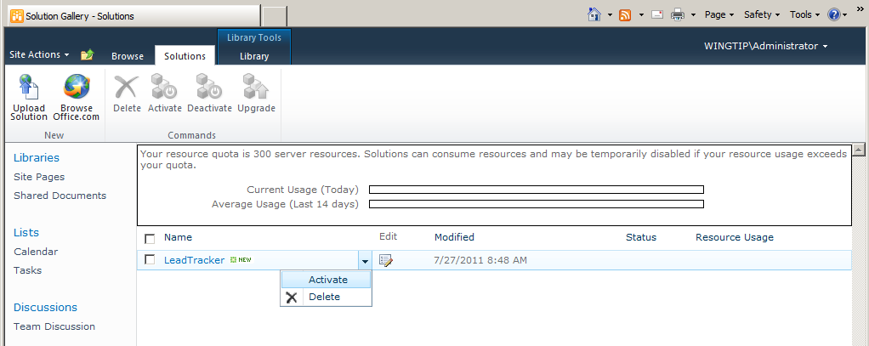
The User Solution Gallery
User Solution Gallery used to manage WSP files
Created automatically in every top-level site
Users can upload and activate solution packages
Users can monitor and deactivate solution packages
Notes:
The User Solution Gallery is the repository for all sandboxed solutions deployed within the site collection. You can access the gallery from the Site Settings page, under the Galleries section, using the link entitled Solutions.
SharePoint 2010 automatically creates the User Solution Gallery in the top-level site every time it creates a new site collection. The main purpose is that privileged users such as site collection owners can upload and activate solution packages. The User Solution Gallery also provides a user interface where users can monitor and deactivate solution packages as well.

Slide 7
User Management of a Sandboxed Solution
Upload
WSP file uploaded to Solution Gallery in top-level site
Activation
Sandbox solution activated to enabled functionality
Site-collection scope features activate automatically
Deactivation
Sandbox solution deactivated to disabled functionality
Site-collection scope features deactivate automatically
Deletion
WSP file deleted from Solution Gallery
Notes:
Keep in mind that there is a terminology difference between the two deployment methods. Farm solutions are installed and deployed. Sandboxed solutions are uploaded and activated. The install step in a farm deployment is similar to the upload step in a sandboxed deployment. Likewise, the deploy step in a farm deployment is similar to the activate step in a sandboxed deployment.
The one notable difference is that the activation of a sandboxed solution automatically activates any feature scoped to the level of the site collection.

Slide 8
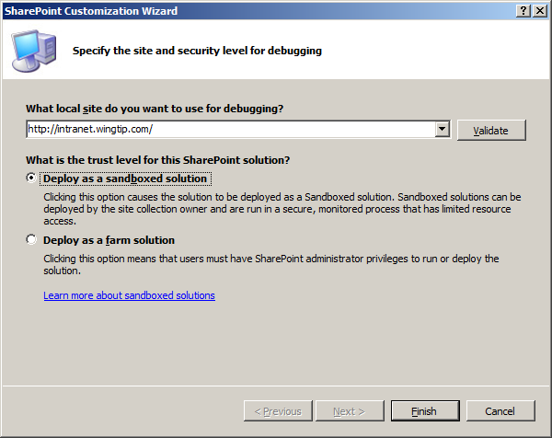
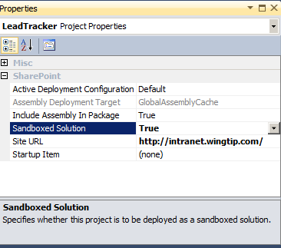
Creating and Testing a Sandboxed Solution
Sandboxed Solutions created with VS 2010
Created as SharePoint projects just like farm solutions
Project property tells VS 2010 how to deploy in testing
Sandboxed solution developed using constraints
Visual Studio 2010 offers some assistance
Developer has to know what works in the sandbox
Notes:
From the perspective of Visual Studio, there is no difference between a sandboxed solution and a farm solution. Both solutions are packaged and built in exactly the same manner. The differences are strictly related to the deployment target and the functionality available to the solution at run time.
When the Sandboxed Solution property is set to True, selecting Build\Deploy Solution deploys the solution to the site collection Solution Gallery.

Slide 9
DEMO
Uploading and Activating
a Sandboxed Solution

Slide 10
Agenda
Understanding Sandboxed Solutions
The Sandbox Execution Environment
Sandbox Resource Monitoring
Breaking Out of the Sandbox

Slide 11
The Sandbox Execution Environment
Sandbox process creates partial trust environment
Sandbox process loads a different version of Microsoft.SharePoint.dll
Sandbox process initialized using Code Access Security (CAS) settings
IIS Worker Process
W3WP.EXE
Sandbox Hosting Process
SPUCHostService.exe
Execution Manager
this process can be configured to run on Web server(s) or dedicated application server(s)
Sandbox Worker Process
SPUCWorkerProcess.exe
MyFarmSolution.dll
this code executes with full trust
MySandboxedSolution.dll
this code executes with partial trust
Microsoft.SharePoint.dll
assembly exposes full object model
Microsoft.SharePoint.dll
assembly exposes partial object model
Custom CAS Policy
policy loaded from wss_usercode.config
Notes:
The sandboxing system uses a component named the Execution Manager to handle the loading and execution of sandboxed solution code. The Execution Manager runs within the IIS application pool and is responsible for making a call out to the User Code Service (SPUCHostService.exe) requesting that a sandboxed solution be loaded.
The User Code Service can be running on many different servers in the farm. You specify load balancing execution across the servers in the farm through administrative settings in Central Administration\System Settings\Manage User Solutions. Using these options, you can choose to execute the sandboxed solution on the same server where the user request was made or on a dedicated set of servers. In either case, the User Code Service makes a request of the Worker Service (SPUCWorkerProcess.exe) to load the sandboxed solution.
Once the assembly of a sandboxed solution is loaded into the Worker Service, its code can be executed. The execution of the code is limited to a subset of the Microsoft.SharePoint namespace and subject to CAS policy restrictions. Any calls to the SharePoint object model are first filtered against the subset object model to prevent any disallowed calls and then executed against the full object model, which runs in the Worker Service Proxy. When the code execution completes, the results are bubbled back up to the client request, which has been waiting synchronously for the request to complete. The final page is then drawn and delivered to the waiting user.

Slide 12
Sandbox-friendly Development
Items that can be used in sandboxed solutions
Features and Feature Receivers
List and Document Library Instances
Event Handlers for Lists and Sites
Site Columns, Content Types and List Definitions
Modules and Templates Files
Web Parts
Site templates created using WebTemplate elements
Custom workflow actions used by SharePoint Designer
Notes:
When designing sandboxed solutions, you have the option of using a declarative, programmatic, or hybrid approach. The purely declarative approach utilizes CAML elements alone to define the solution; a programmatic approach uses only code; and a hybrid approach uses both CAML and code. While many SharePoint solutions are hybrids, a declarative approach is particularly good for sandboxed solutions because no code needs to be deployed to the sandbox. This approach simplifies your solution development considerably. The following is a list of supported CAML elements you can use in your declarative solutions.
ContentType
CustomAction
Field
ListInstance
ListTemplate
Module
PropertyBag
Receivers
WebTemplate
WorkflowActions
WorkflowAssociation

Slide 13
The Subset Object Model
In general
SPSite and below
No SPSecurity
No SPSite construction
No access to Web application or farm
SPSite
SPWeb
SPList
SPListItem
Notes:
Restricting the access of sandboxed solutions to a subset of the Microsoft.SharePoint namespace is intended to prevent solutions from accessing functionality that could destabilize the farm. When sandboxed solutions make calls to the SharePoint object model, the calls are routed through the subset proxy, which in turn makes calls to the full object model. The subset proxy exposes only the following subset of the object model:
All of the Microsoft.SharePoint namespace, except
SPSite constructor
SPSecurity object
SPWorkItem and SPWorkItemCollection objects
SPAlertCollection.Add method
SPAlertTemplateCollection.Add method
SPUserSolution and SPUserSolutionCollection objects
SPTransformUtilities object
Microsoft.SharePoint.Navigation namespace
All of the Microsoft.SharePoint.Utilities namespace, except
SPUtility.SendEmail method
SPUtility.GetNTFullNameandEmailFromLogin method
All of the Microsoft.SharePoint.WebPartPages namespace, except
SPWebPartManager object
SPWebPartConnection object
WebPartZone object
WebPartPage object
ToolPane object
ToolPart object

Slide 14
Writing and Testing Sandboxed Code
Sandbox code uses subset of full object model
Sandbox loads alternate version of Microsoft.SharePoint.dll
Sandboxed version removes many classes and methods
VS 2010 uses IntelliSense to hide these classes and methods
VS 2010 references and compiles against full trust version
No compile-time checks for method not it sandboxed version
There is a workaround to configure compile time checks
Switch Microsoft.SharePoint.dll reference to sandboxed version
{SharePointRoot}\UserCode\Assemblies\Microsoft.SharePoint.dll
Caveat: reference must be switched back after testing
Microsoft.SharePoint.dll
full trust version number is 14.0.0.0
Microsoft.SharePoint.dll
sandboxed version number is 14.900.0.0
Notes:
Sandbox code can only use a subset of the full object model. This restriction is enforced inside the sandbox by loaded an alternate version of Microsoft.SharePoint.dll. This sandboxed version of Microsoft.SharePoint.dll removes many of the classes and methods that are in the full-trust version of Microsoft.SharePoint.dll. Code inside a sandboxed solution will experience run-time errors when attempting to call methods or create object from class not supported inside the sandbox.
Visual Studio 2010 uses a trick with IntelliSense to hide classes and methods that are not available inside the sandbox. However, you should understand that Visual Studio 2010 always add a reference to all SharePoint project based on the full trust version of Microsoft.SharePoint.dll. That means the code in a sandboxed solution will not experience compile-time errors when calling method or classes that are not supported in the sandboxed version. There is a workaround which is to switch the reference from the full-trust version Microsoft.SharePoint.dll reference to the sandboxed version which is located in the following location.
{SharePointRoot}\UserCode\Assemblies\Microsoft.SharePoint.dll
While switching the reference to the sandboxed version provides compile-time check, you should still switch the reference back to the full-trust version before creating a build for distribution. Failure to do so will result in distributing a solution package that cannot be installed as a farm solution.

Slide 15
DEMO
Writing Code for a Sandboxed Solution

Slide 16
Agenda
Understanding Sandboxed Solutions
The Sandbox Execution Environment
Sandbox Resource Monitoring
Breaking Out of the Sandbox

Slide 17
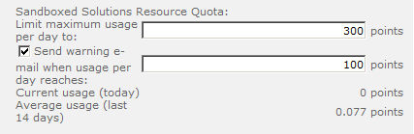
Sandbox Solution Monitoring
Resource usage points monitor code in sandbox
Usage points monitored against configurable quotas
Quotas configured & monitored at site collection scope
Resource usage is monitored on day-to-day basis
Exceeding quota results in automated actions
Exceeding max quota results in disabling sandboxed code
All sandboxed solutions in site collection disabled at once
Sandboxed solutions begin working again at midnight
Notes:
The farm administrator can also specify a quota for sandboxed solutions. Quotas are set up in Central Administration by selecting Application Management\ Configure Quotas and Locks. On this page, the farm administrator can set a limit on the resources that a sandboxed solution can use in a given Web application. This capability is critical to maintaining the stability of the farm.
Resource usage points are used to monitor the execution of code in sandbox. Resource usage points are monitored for each site collection against configurable daily quotas which define how many resource points can be used.
When a site collection exceeds it quota for resource point, all solutions are blocked from executing in the sandbox for remainder of the day. Note that there is no scenario where a single sandboxed solution is blocked. All of them are blocked. Also note the scheme works on a day-to-day basis so block only occurs to the current day ends and the resource point usage always drops to zero at midnight and the sandboxed solution all begin to run again.

Slide 18
Monitored Resources
Metric Name | Description | Units | Resources Per Point | Hard Limit
AbnormalProcessTerminationCount | Process gets abnormally terminated | Count | 1 | 1
CPUExecutionTime | CPU exception time | Seconds | 3,600 | 60
CriticalExceptionCount | Critical exception fired | Number | 10 | 3
InvocationCount | Number of times solution has been invoked | Count | N/A | N/A
PercentProcessorTime | Note: # of cores not factored in | Percentage Units of Overall Processor Consumed | 85 | 100
ProcessCPUCycles |  | CPU Cycles | 1E+11 | 1E+11
ProcessHandleCount |  | Windows Handles | 10,000 | 1,000
ProcessIOBytes | (Hard Limit Only) Bytes written to IO | Bytes | 0 | 1E+08
ProcessThreadCount | Number of Threads in Overall Process | Threads | 10,000 | 200
ProcessVirtualBytes | (Hard Limit Only) Memory consumed | Bytes | 0 | 1E+09
SharePointDatabaseQueryCount | SharePoint DB Queries Invoked | Number | 20 | 100
SharePointDatabaseQueryTime | Amount of time spent waiting for a query to be performed | Seconds | 120 | 60
UnhandledExceptionCount | Unhanded Exceptions |  | 50 | 3
UnresponsiveprocessCount | We have to kill the process because it has become unresponsive | Number | 2 | 1
Notes:
Resource Per Point is how much this contributes to the point limit per day for the site collection. Hard Limit is how much of this resource a solution can use in a single invocation before it is terminated – a maximum use of quota in a single invocation.
Invocation count is used to measure the per-instance cost of a solution for purposes of reporting and assigning to run-time “tiers” for farms that want to separate solutions into multiple different sandbox processes – there is only one by default.

Slide 19
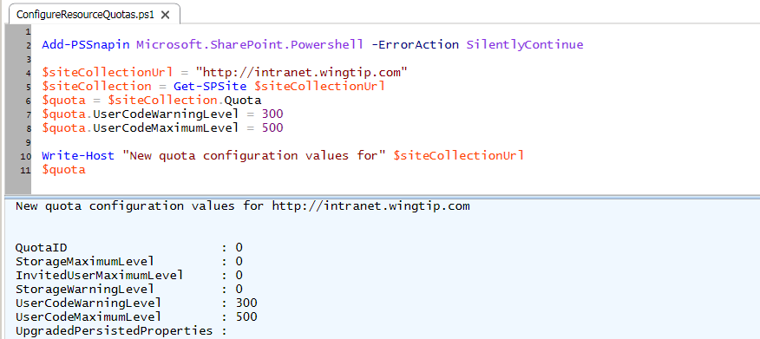
Configuring Quotas
Farm admin configures site collection quotas
Can be done through Central Administration
Can also be done through PowerShell scripts
Notes:
Management of sandbox solutions is handled through the configuration of resource usage quotas which is similar to site quotas for storage limits. Remember that quotas are always configured and monitored at the level of the site collection.
Configuration of quotas can be through Central Administration or using a Windows PowerShell script such as the one shown in the slide above.

Slide 20
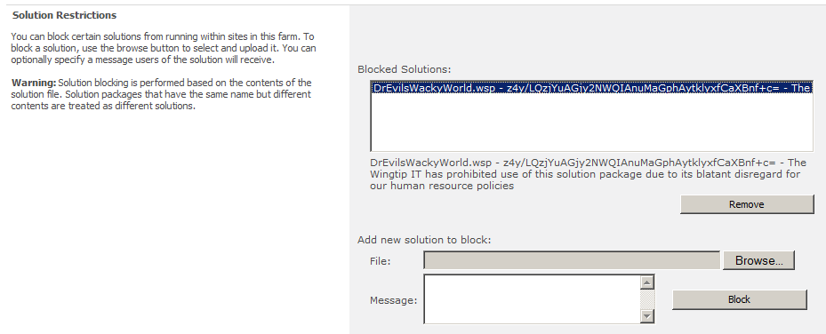
Blocking Sandboxed Solution
Farm administrator can block solution packages
Useful for prohibiting well-known solution packages
Out-of-box blocking support not overly effective
No way to require sandboxed solutions to meet criteria for example, you cannot require sandboxed solutions to be signed with specific key
Greater control achieved by creating custom validators
Notes:
The administrator can control blocked solutions and load balancing by selecting System Settings\Manage User Solutions. On this page, the farm administrator can browse to solution packages that should be blocked and add them to the blocked list. Blocked solutions are not allowed to execute on the farm.
The farm administrator can also select the type of load balancing to use with sandboxed solutions. The administrator can choose to have the solution execute on the same server where the request was received or to have it routed to a dedicated set of servers.

Slide 21
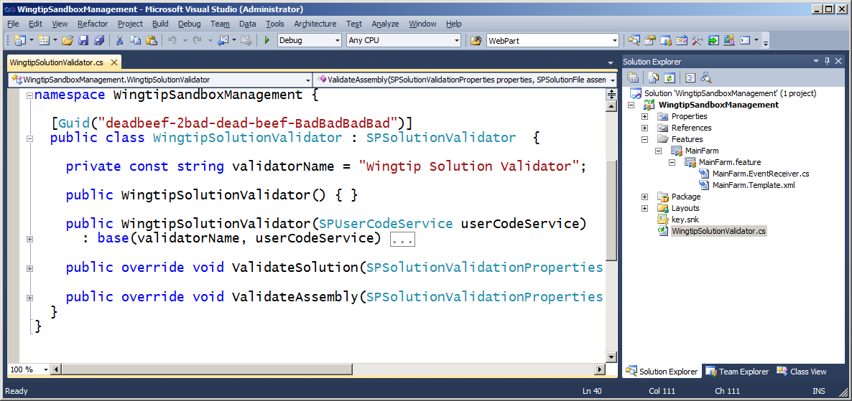
Solution Validators
Custom solution validator can block sandboxed solutions
Validator is custom class that inherits from SPSolutionValidator
Validator class must be deployed using a farm solution
Validator class registered in current farm with farm-scoped feature
SharePoint calls validator class methods during solution activation
Validator class can block solutions that do not meet specific criteria
Notes:
Farm administrators can deploy solution validators to their farm. Note that a validator contains methods that are executed when the user attempts to activate a solution package that has been uploaded to the user solution gallery. If a solution validator rejects a solution package, an error message is shown to the user and the solution package will not be activated.
If a validator is added to the farm after sandboxed solutions have been activated, the validator will be called the next time the sandboxed solution is executed. You can write custom validators by inheriting from SPSolutionValidator class. The validator must be registered which involves adding it to the SPUserCodeServiceSolutionValidatorscollection. The best way to do this is by adding a farm level feature with a feature receiver that register the solution validator class in the current farm.

Slide 22
DEMO
Walkthrough of a SharePoint project
for a Solution Validator

Slide 23
Agenda
Understanding Sandboxed Solutions
The Sandbox Execution Environment
Sandbox Resource Monitoring
Breaking Out of the Sandbox

Slide 24
Breaking Out of the Sandbox
Sandbox imposes significant limitations
For some scenarios, it must be dismissed as an option
You must decide between these options
Work around sandbox limitations with full-trust proxies
Work around sandbox limitations with client-side code
Avoid sandbox, deploy as farm solution
Avoid SharePoint runtime, deploy in separate environment
Notes:
Many times the limitations imposed by the sandbox force some developers to not include it for consideration when working on a business problem. In these scenarios the sandbox can still be leveraged and not dismissed. What developers need to do is to find a way to work within the scope of the sandbox but have certain things “break out of the sandbox.” There are plenty of options to break out of the sandbox:

Slide 25
Full-trust Proxies
SharePoint supports fully-trust proxies
Full-trust proxies created using SharePoint projects
Full-trust proxies must be deployed in farm solutions
Full trust proxies must register operations with farm
Sandboxed solutions can execute registered operations
You can write fully-trusted code callable from sandbox
Sandbox Worker Process
SPUCWorkerProcess.exe
Full-Trust Proxy Worker Process
SPUCWorkerProcessProxy.exe
MySandboxedSolution.dll
executes with partial trust
MyFullTrustProxy.dll
executes with full trust
Microsoft.SharePoint.dll
sandboxed version
Microsoft.SharePoint.dll
full-trust version
Notes:
In this scenario developers create a farm solution that contains code that will run in full trust and can therefore make calls to 3rd party databases, external Web services & feeds as well as access to the complete SharePoint object model.
These are called fully trusted proxies and must be registered with SharePoint at time of installation (typically done using a Feature receiver). A sandbox solution can then access these fully trusted proxies. This scenario is useful when developers want to provide a library of available things, such as a proxy to specific Web services or databases, that can be used from sandbox solutions. The downside is they still require a farm solution to be deployed first.

Slide 26
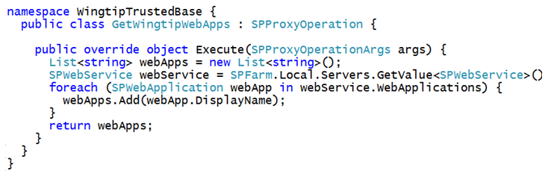
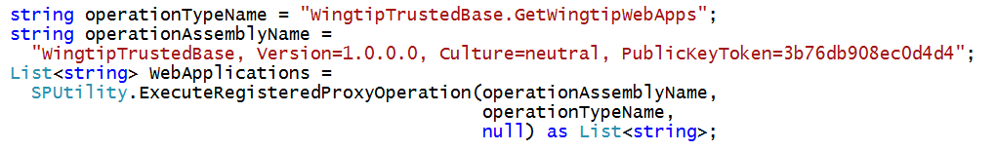
Developing Full Trust Proxies
Full-trust proxy class inherits from SPProxyOperation
Operation called with ExecuteRegisteredProxyOperation
This is the code you would write in the sandboxed solution
Notes:
To create a full-trust proxy, you create a public class that inherits from SPProxyOperation. You then override the Execute method to expose an operation. You need a separate class for each operation.
Once a full-trust proxy has been installed and it has registered one or more operations in the current farm, it can be called from sandboxed solutions. The code in a sandboxed solution calls an operation using the ExecuteRegisteredProxyOperation method exposed by the SPUtility class. Note that this approach requires passing proxy operation class named and the 4-part assembly name as a string and it also lacks type safey because the Execute method is defined with a generic return type of System.Object.

Slide 27
Sandbox Solution with Client-side Code
Create sandbox solutions with more client-side code
Sandbox only poses limitation on server
Client-side code can be created using JavaScript and jQuery
Client-side code can be created using Silverlight
Client-side code more capable than sandboxed code
Client-side code can access content in current site collection
Client-side code can call across the network to access data
You can populate SharePoint list with content from Internet
Notes:
In this scenario the sandbox is simply used to load something that will run within the client (browser). The application would be served up as dynamic content using something like JavaScript & jQuery or a compiled solution using Silverlight.
This scenario is useful when the resource measures are causing issues with the application or when the application needs to leverage external Web services and feeds as Silverlight can do these things. These applications would thus not run within the sandbox and would not be subject to the same limitations.

Slide 28
Running Outside of SharePoint
Sometimes running outside of SharePoint is best
Create Web app running outside of SharePoint
Windows Azure provides hosting of Web app
Windows Azure designed to support long running process
Web app surfaced in SharePoint sites using IFRAME
Notes:
In this scenario developers would build an application that runs 100% external to SharePoint. If the application needs to talk to SharePoint, it can do so using the REST API or the client object model (both covered in another module). The application would not be subject to any of the limitations imposed by the sandbox nor limitations of SharePoint (for instance, developers could create ASP.NET MVC or NET Framework 4.0 applications).
These applications would be hosted on a different Web application (either the same SharePoint servers or on different servers). The applications could then be surfaced in SharePoint numerous ways… using Silverlight or even as simple as an IFRAME that points to the application. End users wouldn’t know the difference! Another option is to push these web applications up to the cloud such as Windows Azure for scalability and even move long running processes to Azure as worker processes instead of SharePoint timer jobs.
Microsoft’s Developer & Platform Evangelism (DPE) group has released a training kit on integrating SharePoint 2010 and Windows Azure if you want to learn more about this technique: http://msdn.microsoft.com/en-us/SPAzureTrainingCourse

Slide 29
Summary
Understanding Sandboxed Solutions
The Sandbox Execution Environment
Sandbox Resource Monitoring
Breaking Out of the Sandbox

